Slide 1
A Machine Learning-Based Framework for phishing detection and Prevention
Ibrahim Maalej, Anthony Polak, Emanuel Ruiz

Slide 2
Table of contents
Introduction
Dataset
Model
Web Infrastructure
Conclusion
Q & A

Slide 3
Introduction

Slide 4
What is Machine Learning?
What is Phishing?
Definition:
A branch of artificial intelligence focused on enabling computers to learn from data.
Purpose:
Automate decision-making and predictions based on patterns in data.
Types:
Supervised, unsupervised, and reinforcement learning.
Definition:
A type of cyber-attack where attackers attempt to deceive users into providing sensitive information.
Methods:
Often involves fraudulent emails, messages, or websites.
Impact:
Can lead to identity theft, financial loss, or unauthorized access to data.
Notes:
Exploring other methods

Slide 5
Dangers of phishing
52%
22%
$44.2 M
97%
FBI's 2021 Internet Crime Report shows phishing attacks accounted for 22% of all data breaches
$44.2 Million was stolen by cyber criminals through phishing attacks in 2021. (AAG IT)
Intel study shows 97% of people fail at identifying phishing emails from genuine emails
Notes:
Exploring other methods

Slide 6



Our Solution
The overarching problem addressed by this project is the persistent vulnerability of individuals and organizations to phishing threats.
We set out to design a sophisticated AI model-based tool aimed at enhancing cybersecurity and protecting users through the detection of link-related phishing attacks in web content

Slide 7




Methodology
Research the problem
Find the data
Build the model
Develop the tool
Understand the intricacies of phishing attacks, their indicators, and machine learning models
Gather comprehensive datasets containing benign and phishing links, ensuring that the data is diverse and up-to-date.
Utilize machine learning algorithms to construct a classifier that can accurately distinguish between safe and phishing links.
Integrate the model into a user-friendly application, providing real-time phishing detection to assist users in staying secure online.

Slide 8
Dataset

Slide 9
Dataset Acquisition and Preparation
Final datasets built upon:
Grega Vrbančič's https://doi.org/10.1016/j.dib.2020.106438
Abdelhakim Hannousse and Salima Yahiouche's https://doi.org/10.17632/c2gw7fy2j4.3
Datasets are cleaned, transformed, enriched, merged, and trimmed using pandas.
65.36% Non-phishing Links, 34.64% Phishing Links
Shape: (40,000, 116)
40,000 Instances
116 Features
Notes:
Exploring other methods

Slide 10
URL Featurization
Protocol
Domain Name
Directory
File / Page
https://www.example.com/info/aboutus.html
Length of the URL and its sub-components
Quantity of special characters and their ratios in different parts of the URL
IP address as domain
Redirections
Suspicious keywords within sub-components
HTTPS as the protocol or a part of another section of the URL
Host Name
Path
Notes:
Exploring other methods

Slide 11
Domain Featurization
DNS Record
Domain Age
Quantity of Resolved IPs
Quantity of servers
MX servers
Name servers
Indexed by Google
Time response
TLS/SSL Certification
Page Rank (Tranco)
Notes:
Exploring other methods

Slide 12

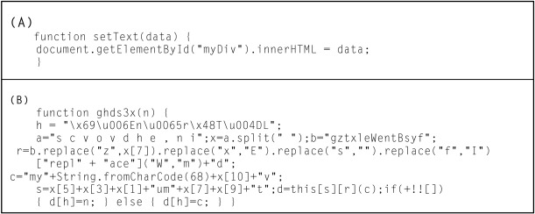
Room for improvement
HTML/JAVASCRIPT ELEMENTS from url pages
Existence of Favicon
Javascript Obfuscation
Extraction of HTML tags from the page
<script>, <meta>, <link>, <a>

Slide 13
Model

Slide 14




Model Development
Research​
Model Selection
Featurization & Analysis
Final Implementation
Researched many potential methods to handle the phishing classification problem
Numerous models pitted against each other to find best performance
Features chosen and analyzed for maximum impact and coverage
Implement & combine everything together to construct model ensuring reliable and efficient detection

Slide 15
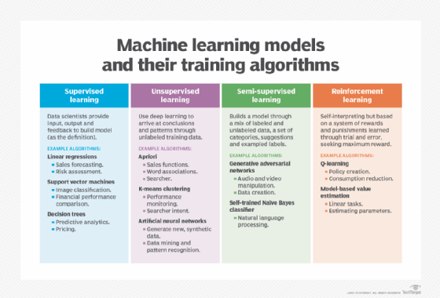
Research
Languages and Packages:
Many languages and Packages to choose from
Python using scikit-learn as main foundation found to be most suitable
Feature Types:
Various possible types such as text-based, URL-based, HTML-Based, signature-based, etc.
Chose URL-based with some signature-based mixed in
Classification Methods:
Numerous methods such as supervised, unsupervised, etc.
A Supervised method chosen to compliment URL-based features
Phishing Indicators
Many types of attacks
What signals a possible URL-based attack?
Common metrics like checking google page rank or URL shortening services
Fig 1. The four main types of machine learning and their most common algorithms.
Notes:
API SERVER
Processes API calls with Python to make predictions and return result to the web client
WEB SERVER
Provides a responsive webpage to act as an interactive and accessible interface to make the predictions

Slide 16
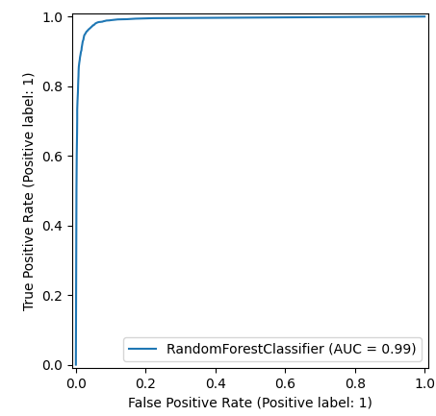
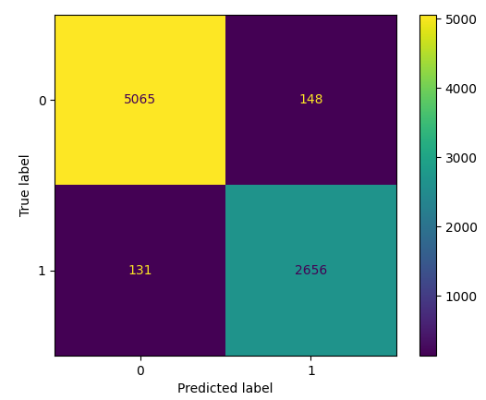
Model Selection
 | Precision | Recall | F1-Score | Test Score | Train Score
Random Forest | 0 | 0.97 1 | 0.94 | 0 | 0.97 1 | 0.95 | 0 | 0.97 1 | 0.94 | 0.961 | ​0.999
Light GBM | 0 | 0.97 1 | 0.94 | 0 | 0.97 1 | 0.95 | 0 | 0.97 1 | 0.94 | 0.960 | ​0.977
Logistic Regression | 0 | 0.95 1 | 0.87 | 0 | 0.93 1 | 0.91 | 0 | 0.94 1 | 0.89 | 0.922 | ​0.924
Decision Tree | 0 | 0.95 1 | 0.92 | 0 | 0.96 1 | 0.91 | 0 | 0.96 1 | 0.92 | 0.944​ | ​1
Naïve Bayes | 0 | 0.92 1 | 0.80 | 0 | 0.89 1 | 0.86 | 0 | 0.91 1 | 0.83 | 0.879 | ​0.879
Support Vector Machine | ​0 | 0.70 1 | 0.81 | ​0 | 0.98 1 | 0.20 | 0 | 0.81 1 | 0.31 | ​0.707 | ​0.707
Multilayer Perceptron | 0 | 0.83 1 | 0.95 | 0 | 0.98 1 | 0.63 | 0 | 0.90 1 | 0.75 | 0.859 | ​0.862
BEST | Random Forest​ | Random Forest | Random Forest | Random Forest | Decision Tree
Fig 2. Random Forest AUC/ROC Display
Fig 3. Random Forest Confusion Matrix

Slide 17
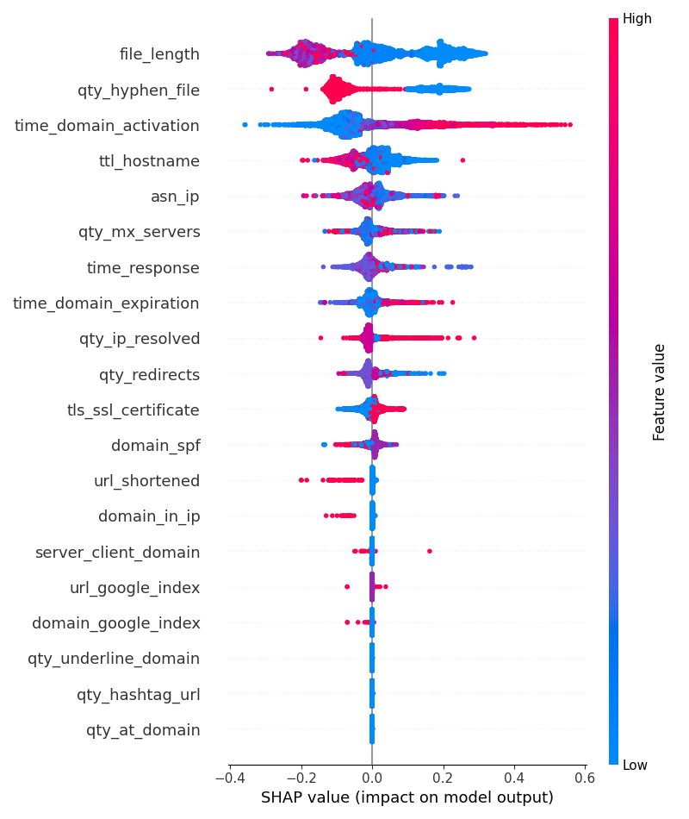
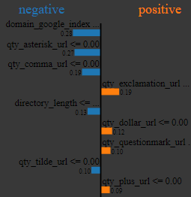
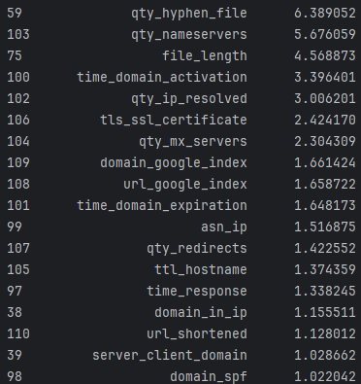
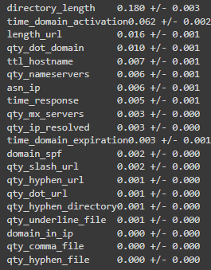
Feature Analysis
Fig 7. LIME Feature Insights
Variance Inflation Factor (VIF):
Assess multicollinearity among features to ensure that each feature provides unique information to the model.
SHAP:
values to understand each feature's contribution to the model's predictions and their impact on classification outcomes.
Permutation Importance:
Measure the importance of each feature by observing the change in model performance when the feature's values are randomly permuted.
LIME
provide interpretable insights into the model's predictions for specific instances by approximating the model with a simpler, interpretable model.
Fig 4. SHAP Summary Graph
Fig 5. Permutation Importance
Fig 6. VIF Inflation Factor

Slide 18
Final Implementation
IMPLEMENTED USING PYTHON, INCLUDING LIBRARIES AND PACKAGES SUCH AS SCIKIT-LEARN, PANDAS, ETC.
900+ lines of code with feature implementation
Trained on final processed quality dataset
115 Features, 1 target
Hyperparameter Tuning for best results
10-fold cross validated, 0.91 Matthews coefficient
96% accuracy, f1-score, precision, recall on average
Strong, Reliable and efficient model for detection
Notes:
Exploring other methods

Slide 19
Web Infrastructure
22%

Slide 20
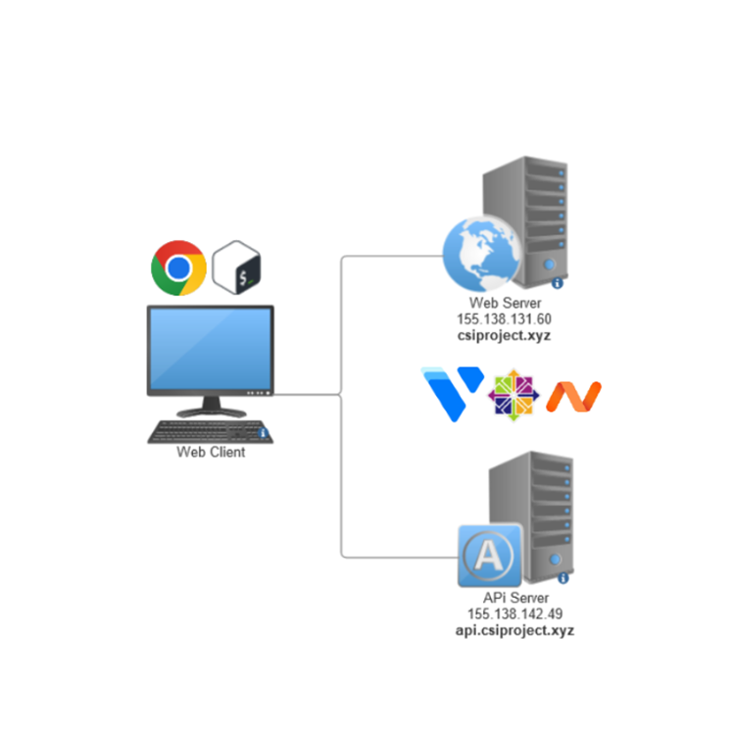
Our servers
VULTR Provides:
Hardware Resources for computation Toronto DC - Regular Cloud Compute 1 vCPU, 1024 MB RAM, 25 GB SSD, 1.00 TB Transfer (5$/mo)
DNS (supporting SLD)
Firewall
Reserved IPs
Snapshots and Optional Upgrades
Namecheap provides:
TLD – csiproject.xyz
Shared configurations
Centos Stream 9
Certbot certificates
Firewall ports opened
Notes:
API SERVER
Processes API calls with Python to make predictions and return result to the web client
WEB SERVER
Provides a responsive webpage to act as an interactive and accessible interface to make the predictions

Slide 21
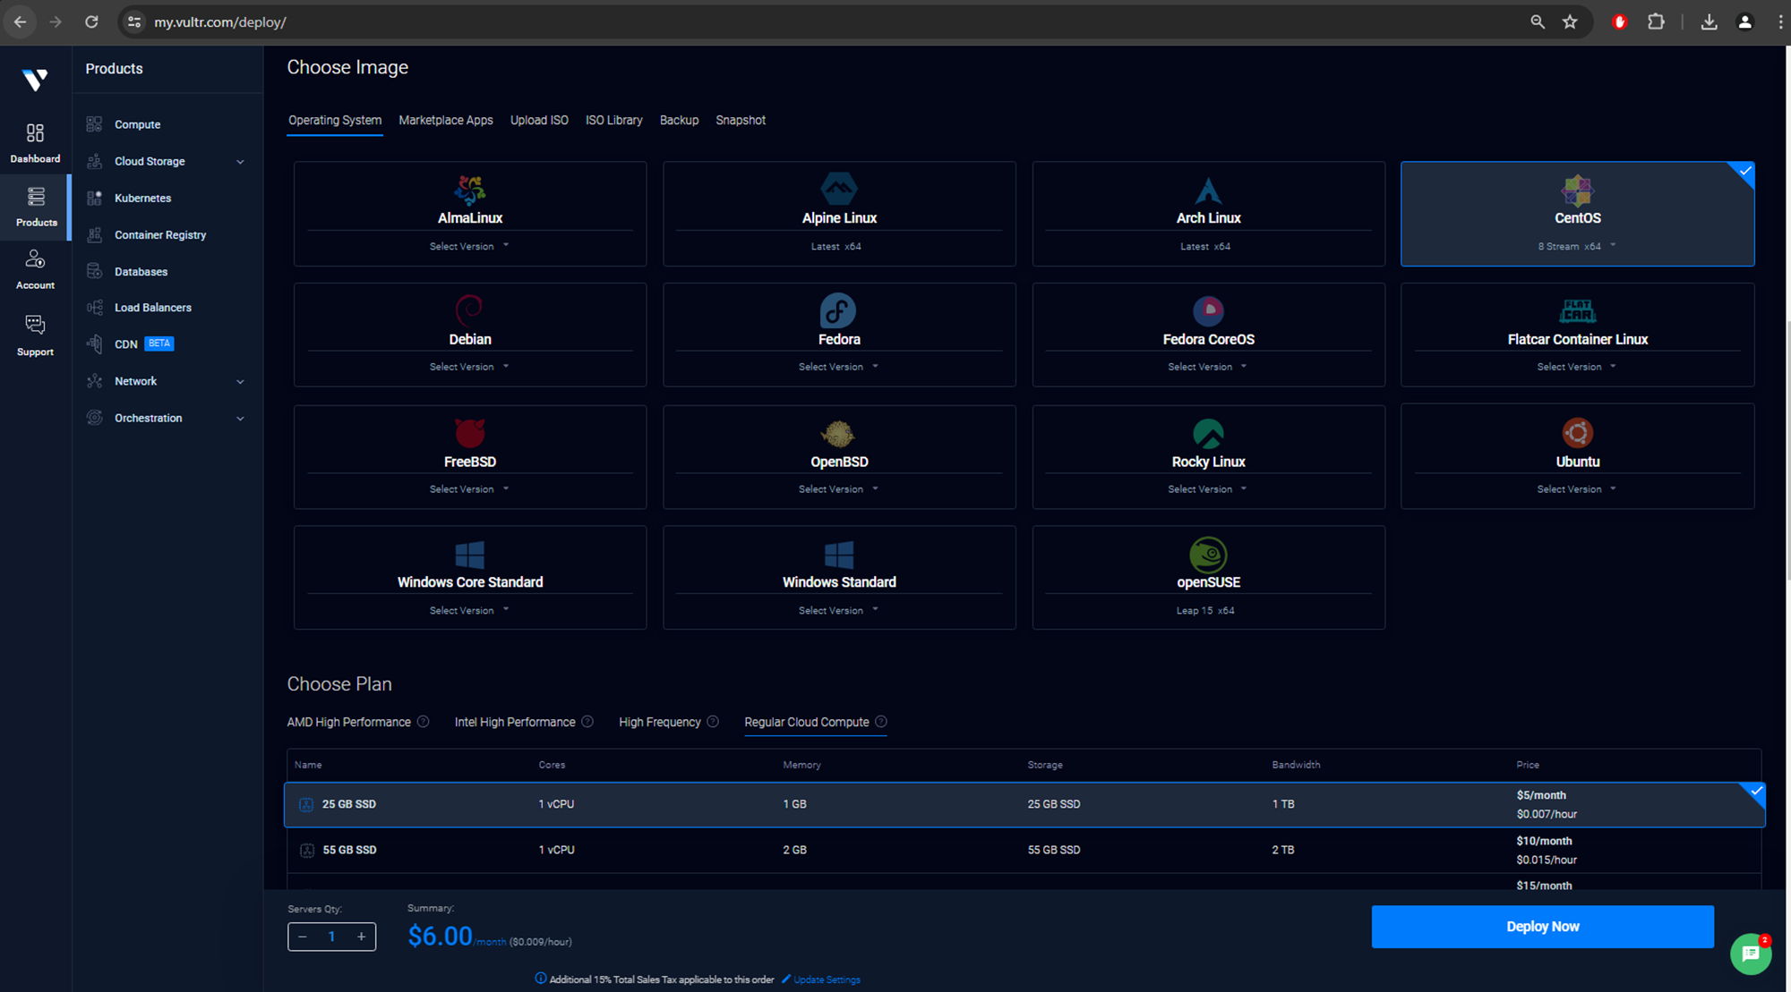

Slide 22
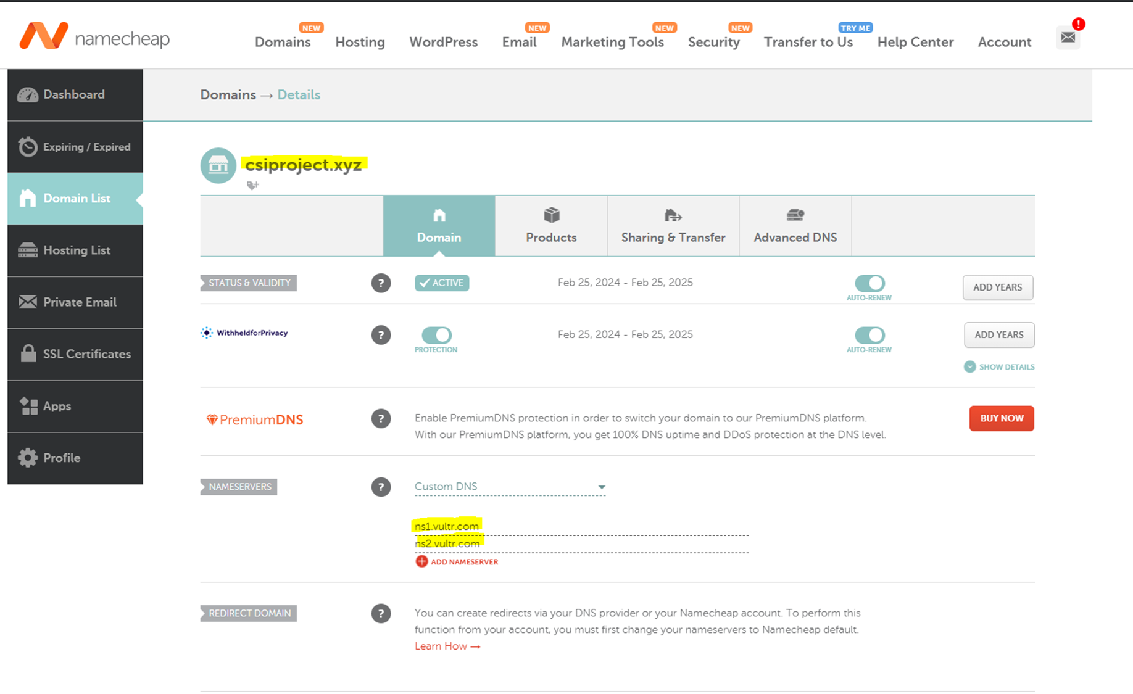

Slide 23
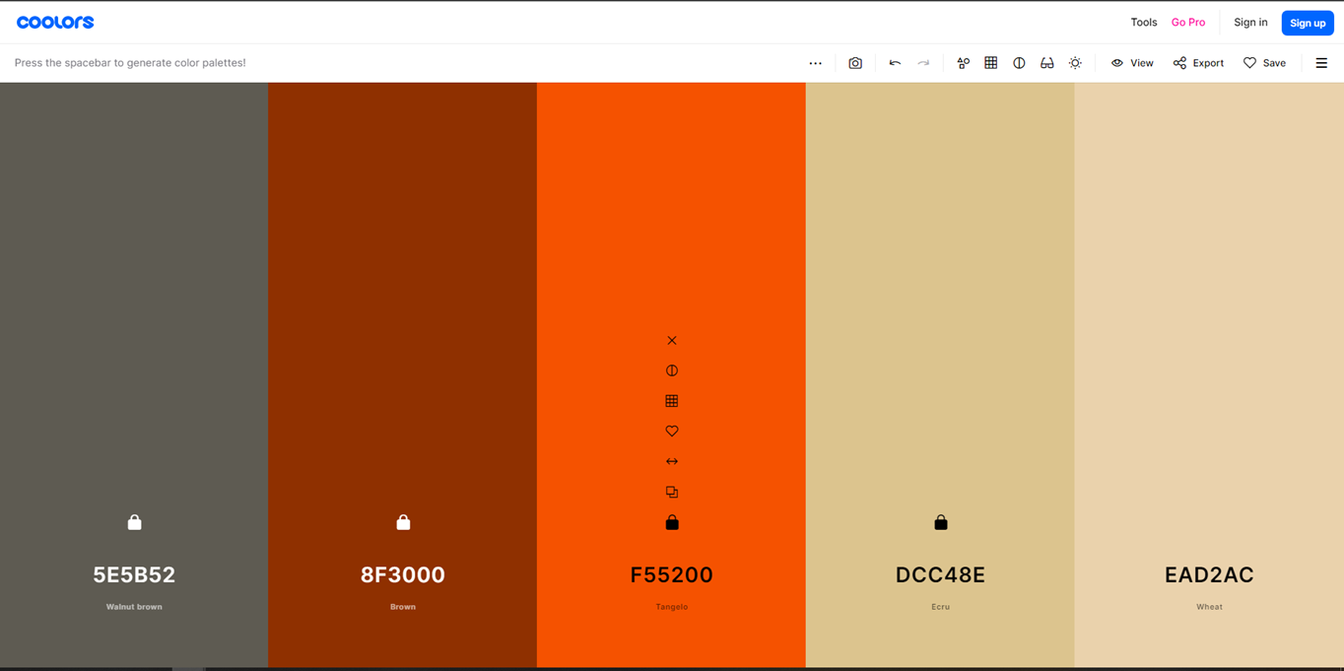
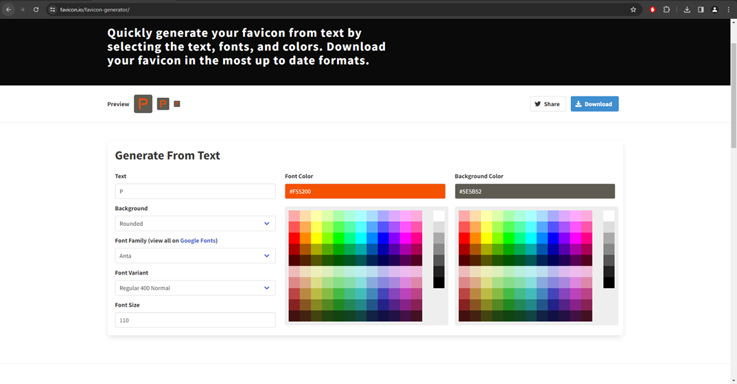
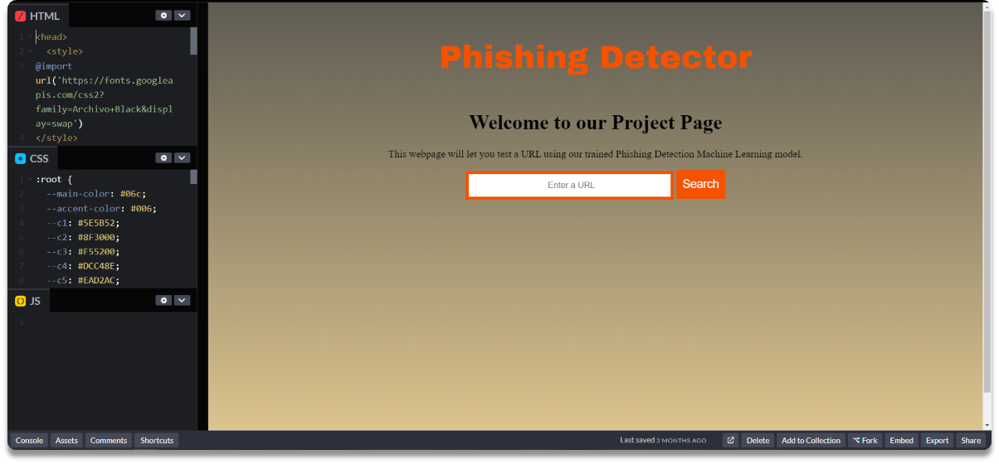
design
Start with basic HTML, CSS, JS
Keep it simple and consistent
Introducing more elements adds complexity

Slide 24
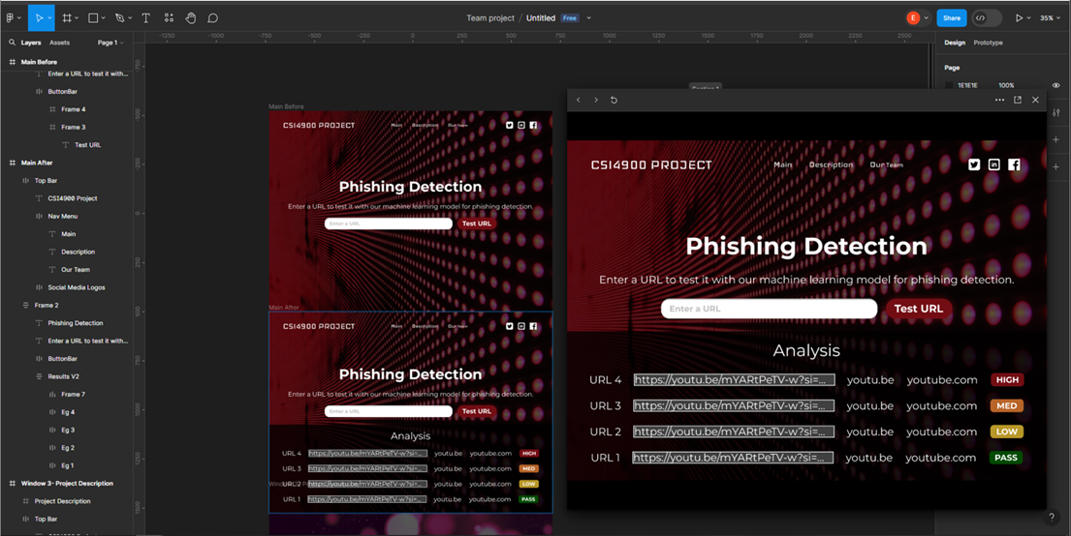
design
Figma for prototyping
Notes:
Exploring other methods

Slide 25
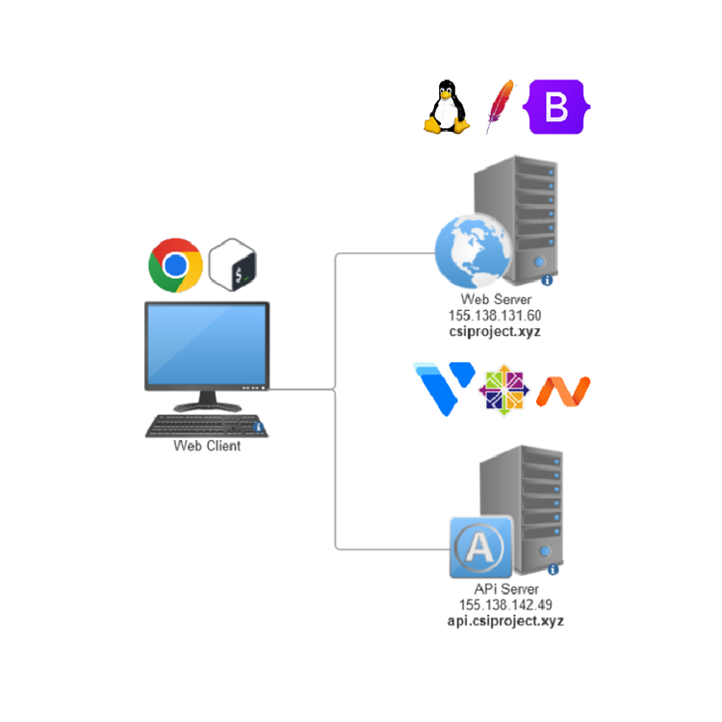
WEB SERVER DETAILS
Using Apache as the Web Server app
Sending our webpage files which now incorporate the Bootstrap framework
Apache configured to use HTTPS (port 443) and 303 Redirect (http -> https)
Self-signed certificate -> Certbot These are important for modern websites as web browsers will often complain
Notes:
More details before sharing final look

Slide 26
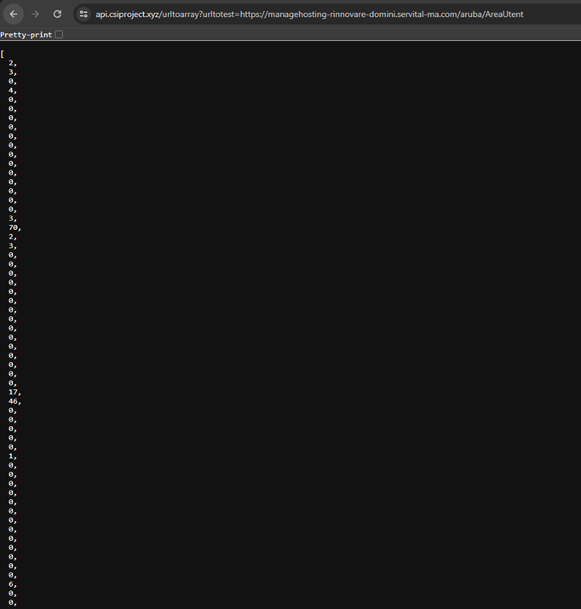
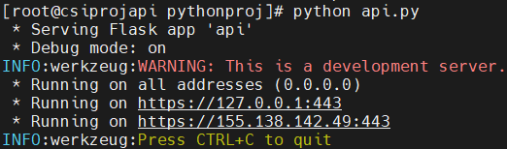
Api server DETAILS
Using Flask – Python web framework that can be used for APIs
Using PIP to install all our Python packages
Code functionality of API endpoints with Python
Storing trained model as joblib
Set up Certbot certificate

Slide 27
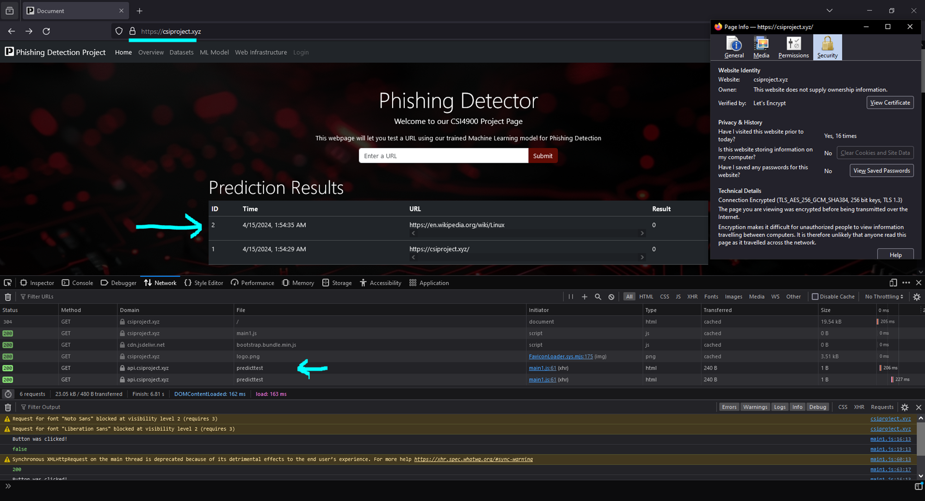
Results
Notes:
What are the results of this work?
Displays information, looks decent, interacts with our API, is secure for it's purposes, easy name to remember - accessible

Slide 28
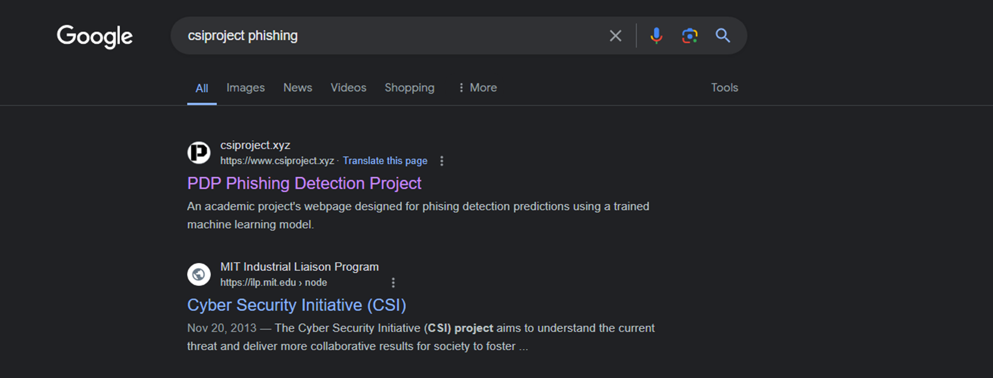
Results
Notes:
Can be found via a google search

Slide 29
Conclusion
Through the design and implementation of a machine learning model and tool for phishing detection, we aimed to help combat the ever-evolving cyber security threats that impact individuals and businesses alike.

Slide 30
Thank you
Are there any questions?

